Slide 1

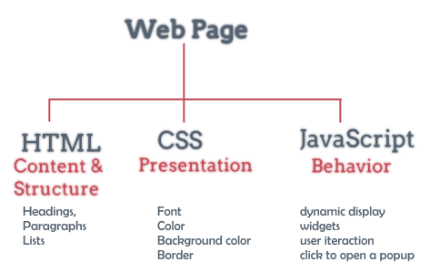
Web Design Overview

Slide 2
Lesson Objectives
Understand the step-by-step process of setting up a website, some methods of designing and building an effective website
Understand the concepts related to buying a domain name, renting a place to host a website
Understand the process of deploying and putting the website into operation

Slide 3
Lesson content
Steps to set up Website:
Determine the requirements of the website
Buy domain name
Rent a hosting place
Website design
Deploy Website
Maintain information, maintain website

Slide 4
1. Determine the requirements of the website
Goals and requirements of the website
The users that the website serves
Topics of the website

Slide 5
Goals and requirements of the website
Outline the general, concise and clear goals of the website to be designed
As a tool to evaluate the success or failure of the website
Goals must be long-term, covering the entire development plan.

Slide 6
Users that the website serves
Identify the main type of website audience
Learn about:
Knowledge
Level
Interest
Experience in using computers, browsing the web
….

Slide 7
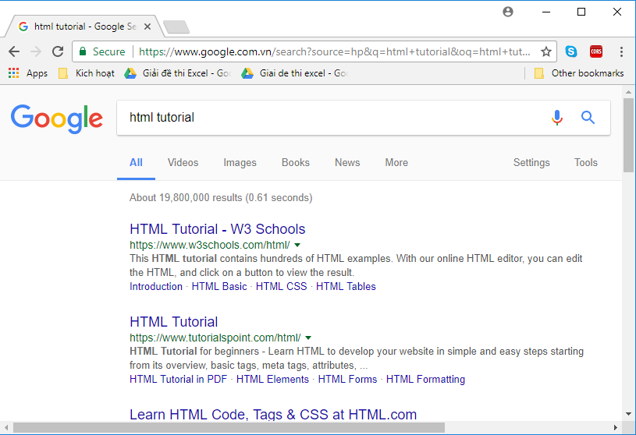
Users that the website serves
Good web design = suitable for all types of readers with different levels and needs

Slide 8
Topics of the website
Help guide designers
Education
News
Entertainment
Discussion forum
Buy, sell, manage
Social network
…

Slide 9
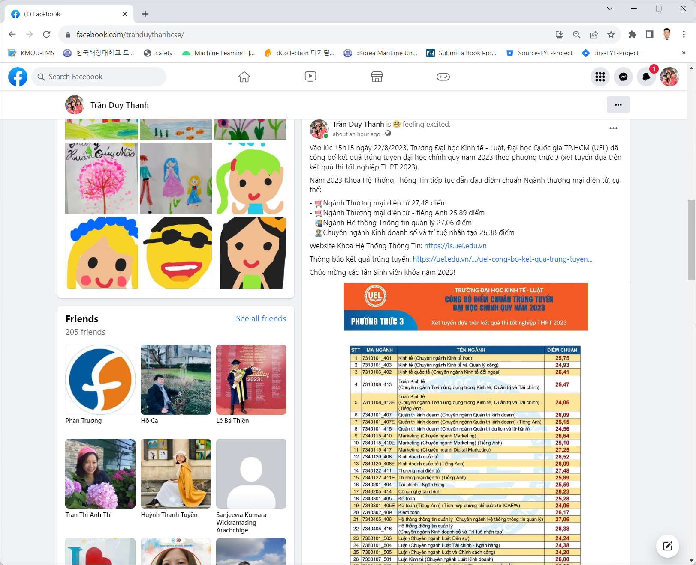
Topics of the website
Social network:

Slide 10
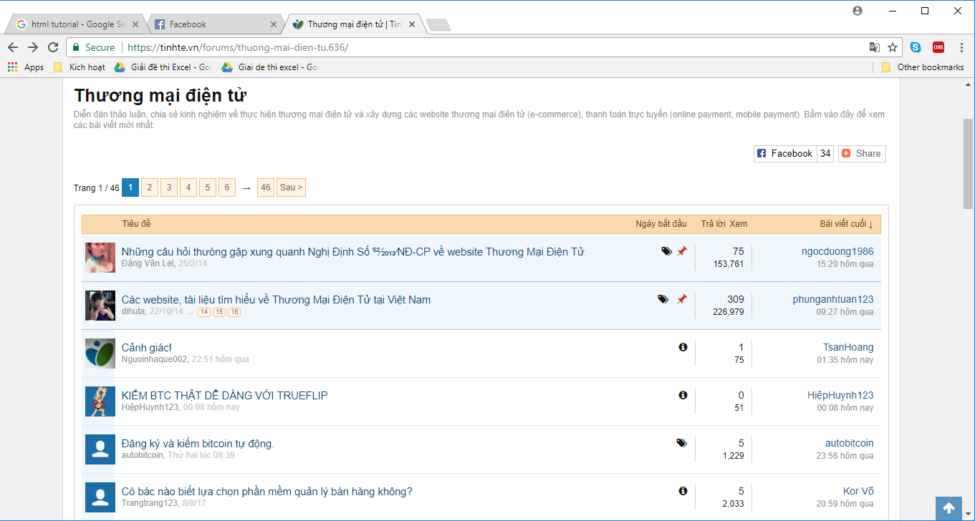
Topics of the website
Discussion forum topic

Slide 11
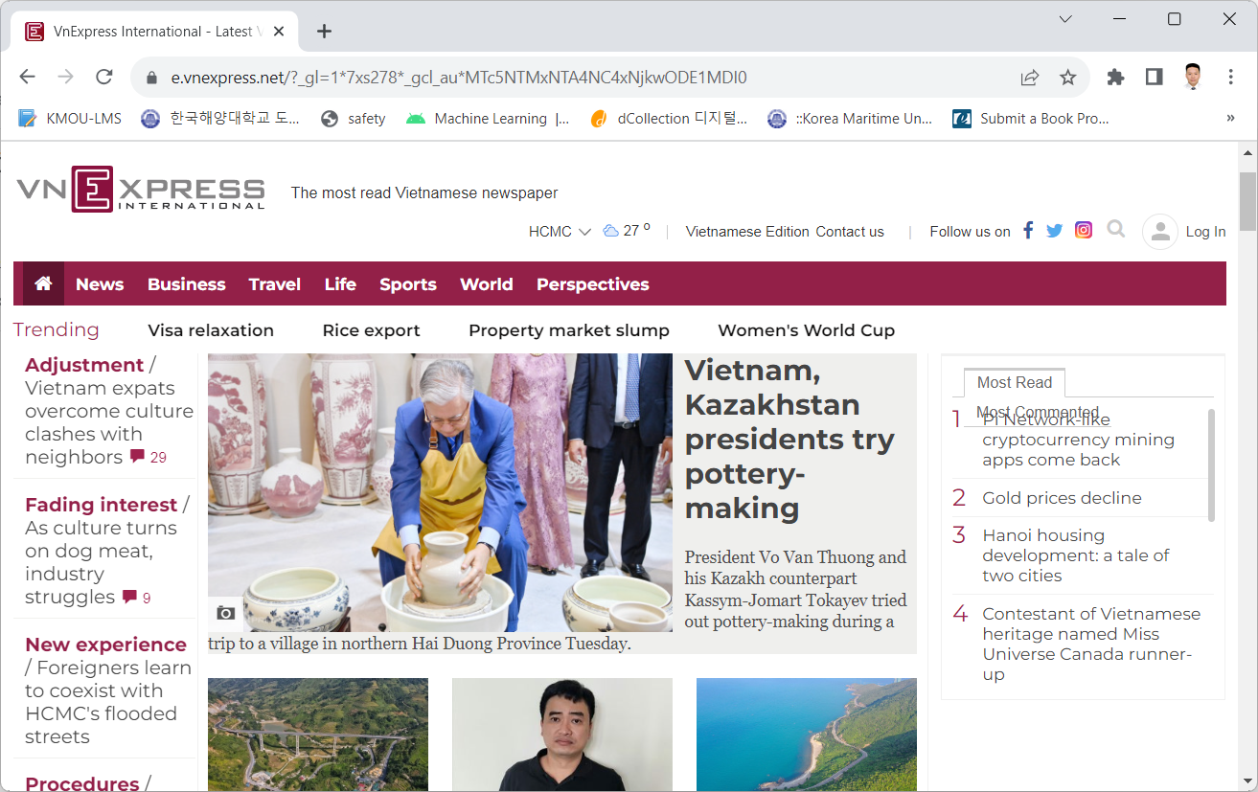
Topics of the website
Online news topics

Slide 12
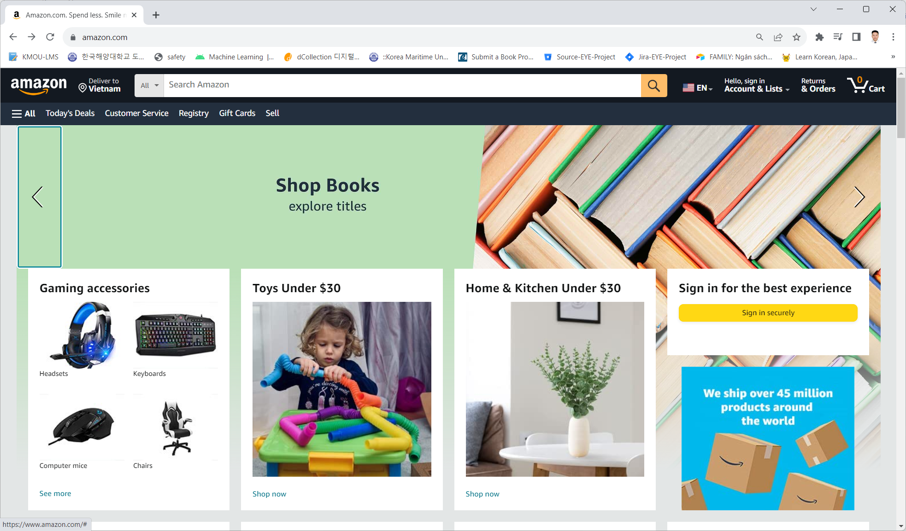
Topics of the website
Online shopping topic

Slide 13
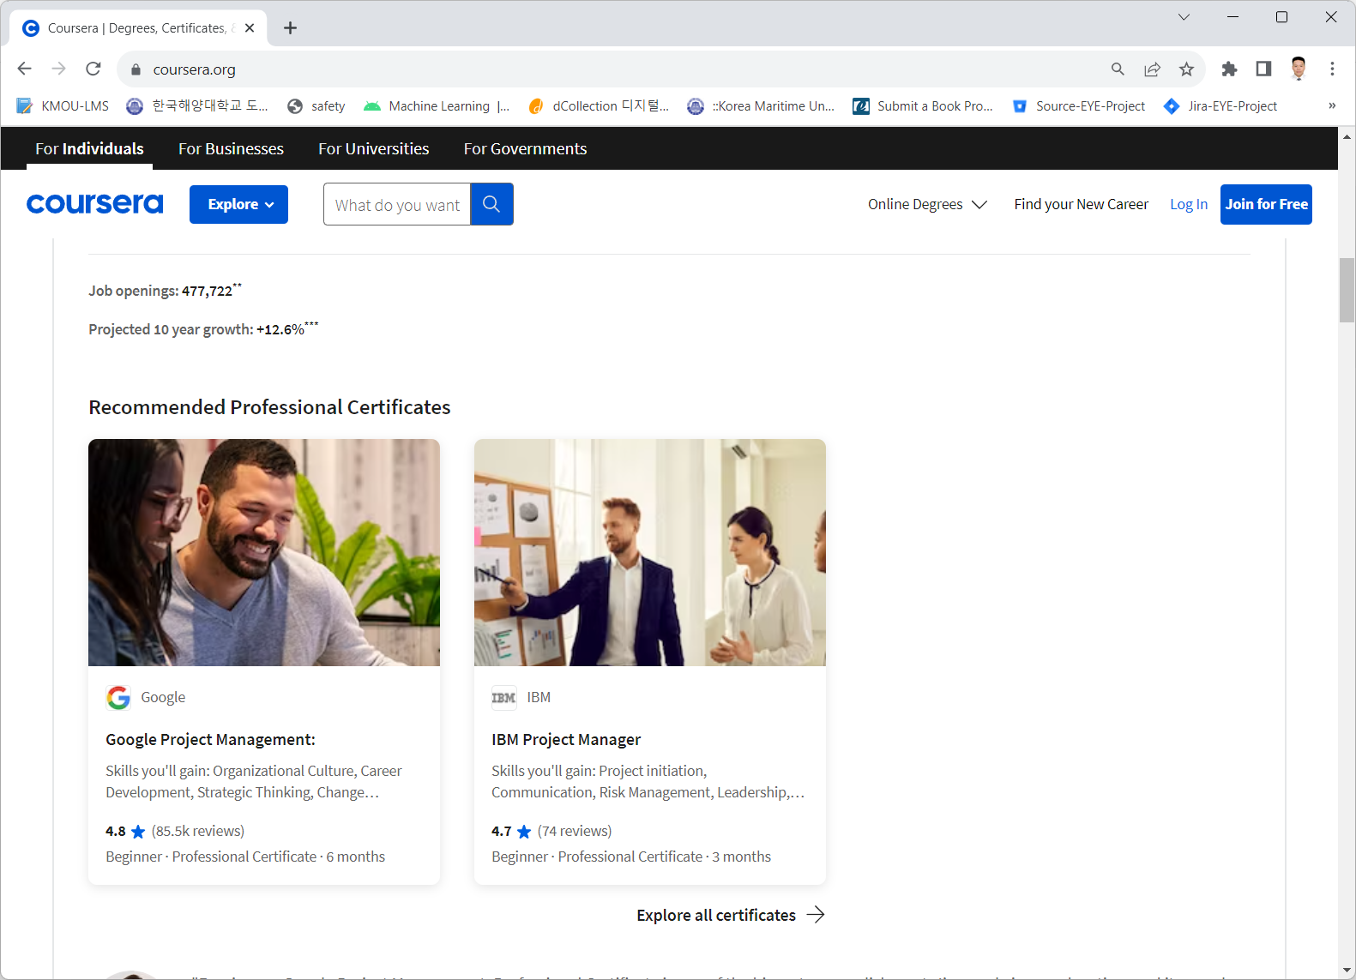
Topics of the website
Online training topics

Slide 14
2. Buy a domain name
Domain name = website name
Short name
Memorize
Easy to read
No confusion
Show company name or company brand
google.com
facebook.com
tuoitre.com.vn
tranduythanh.com

Slide 15
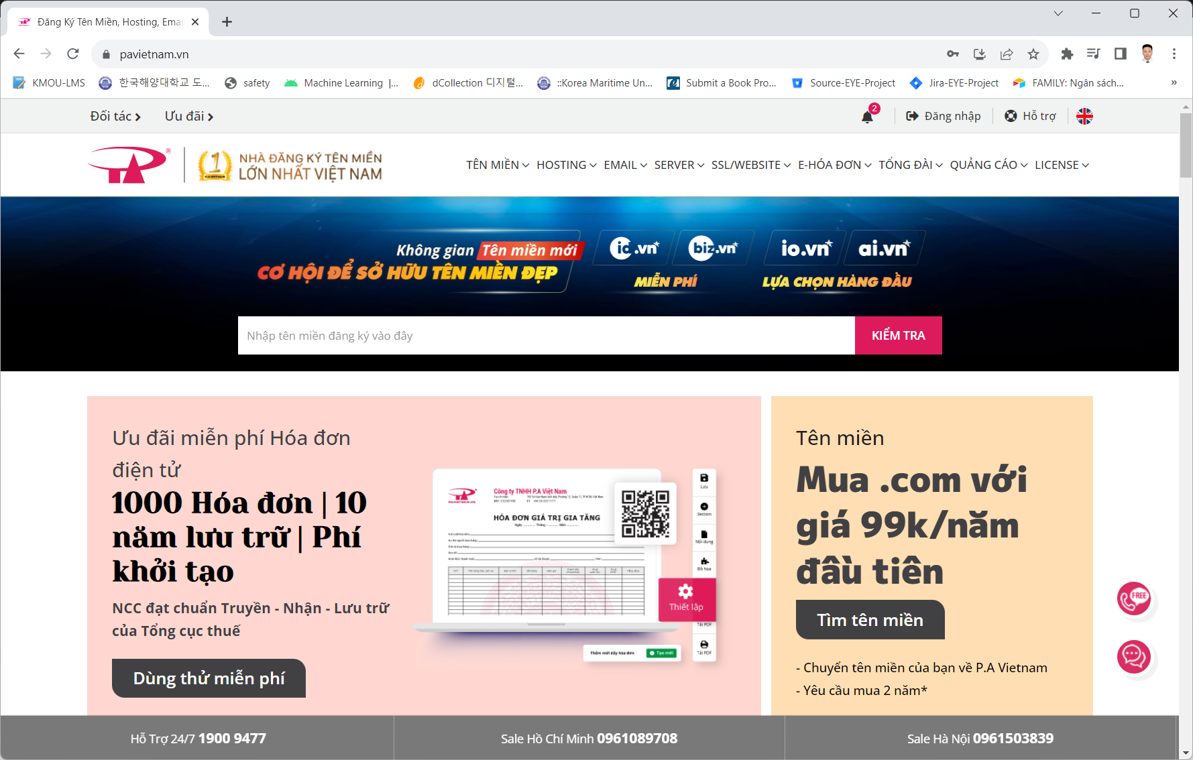
2. Buy a domain name
http://pavietnam.vn

Slide 16
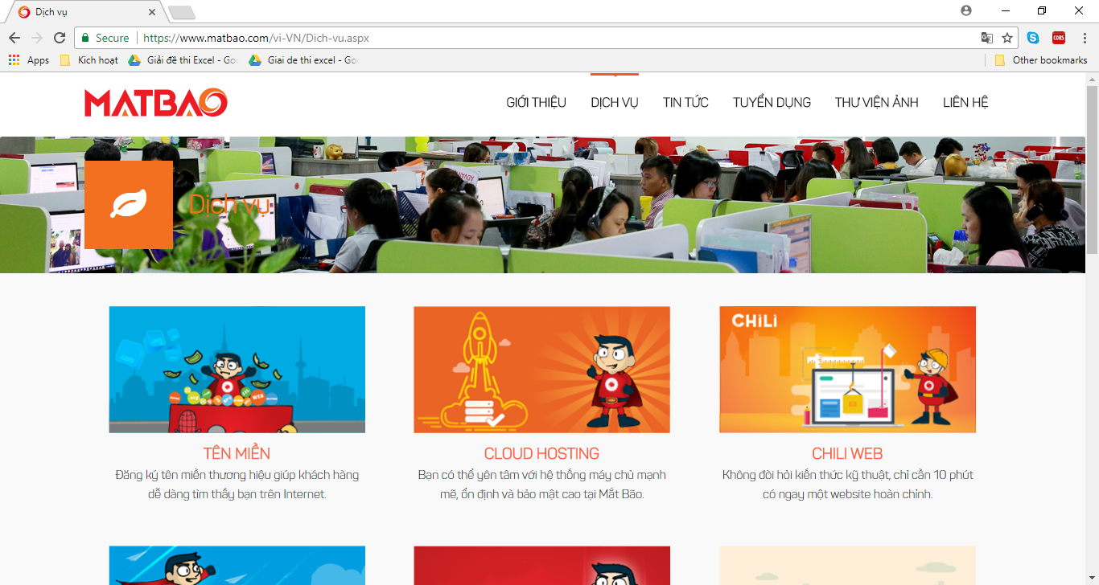
2. Buy a domain name
http://matbao.com

Slide 17
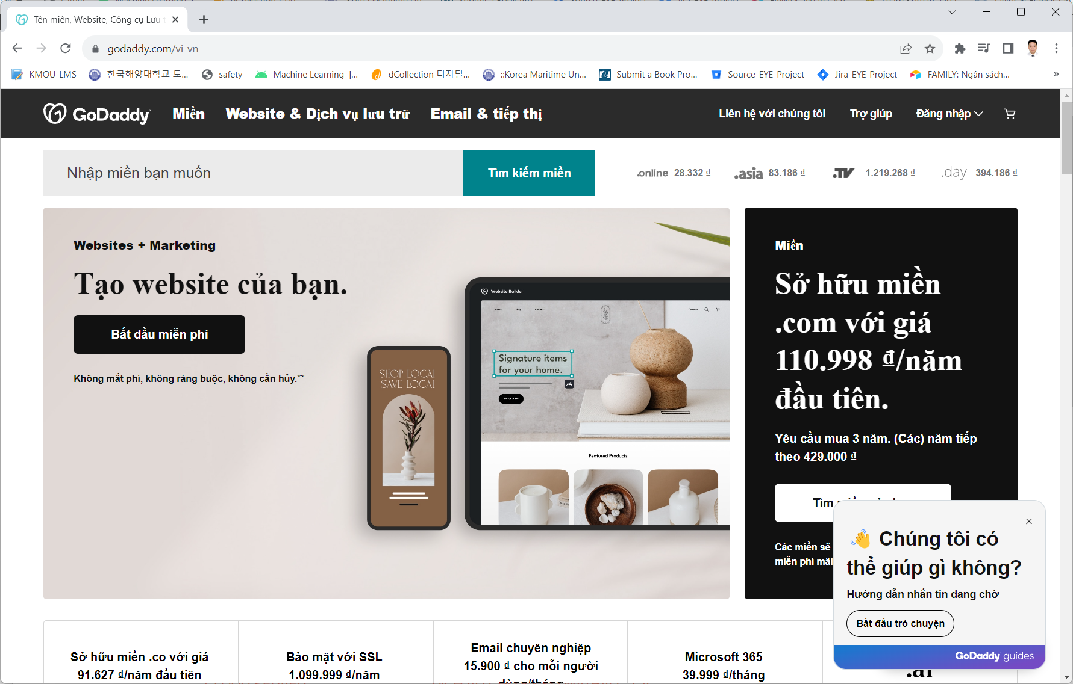
2. Buy a domain name
http://godaddy.com

Slide 18
3. Rent hosting
Operating system
Capacity
Bandwidth
Support language
Supported database management system
Email POP3
….

Slide 19
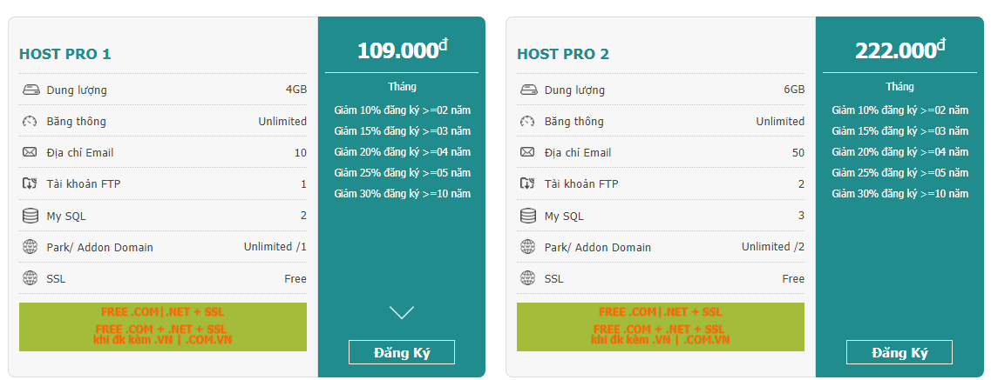
3. Rent hosting
Linux hosting

Slide 20
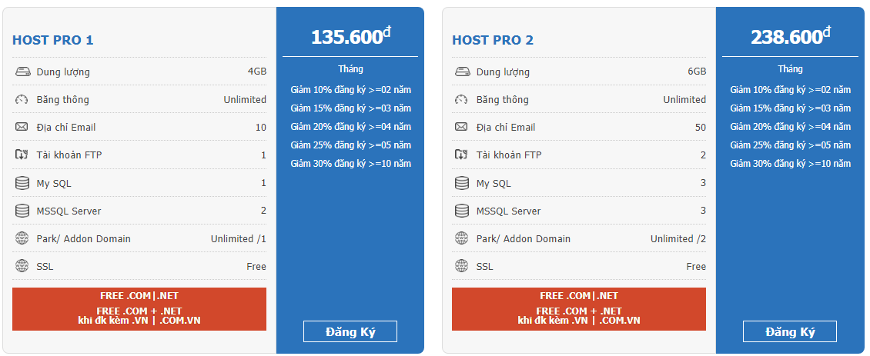
3. Rent hosting
Windows hosting

Slide 21
3. Rent hosting
What if students do not have money but want to have Free?
https://azure.microsoft.com (email education)
https://somee.com
https://freevnn.com
https://www.000webhost.com
https://www.freehosting.com
https://www.awardspace.com/free-hosting
https://vhost.vn/hosting/free-hosting

Slide 22
4. Website Design
Static Web | Dynamic Web
Easy to develop Interaction with weak web browser Use HTML language to design Static web developers often use visual tools to create websites like FrontPage. Do not receive feedback from users. | More difficult to develop Interact with strong web browsers Use different languages for programming Often have to write a lot of code Get feedback from users

Slide 23
4. Website Design
Just like the analysis and design of information systems, the basic steps for developing a website include:
Specific description
Analysis
Design
Programming (website building)
Test

Slide 24
4. Website Design
Specific description:
Web for what?
Web for whom to use?
What is the level of the user?
Content and images like?
Analysis:
The relationship between the website content?
Order of the site content?

Slide 25
4. Website Design
Design:
Website structure diagram
Display
Static web or dynamic web?
Database Design Database?
Content of each page
Links between pages
Build/Develop:
Directory structure
Shared modules
…

Slide 26
4. Website Design
Test
Test in multiple browsers
Test on multiple network configurations
Speed test
Check the links (links)
Security check
……

Slide 27



4. Website Design
 | Header
Menu | Content
Logo

Slide 28
4. Website Design
 | Header
Menu | Content | Menu
Logo

Slide 29
4. Website Design
Font will depend on:
Set information points
Readers
Browser, resolution
Language used
Font
…
The color should unify the entire website

Slide 30
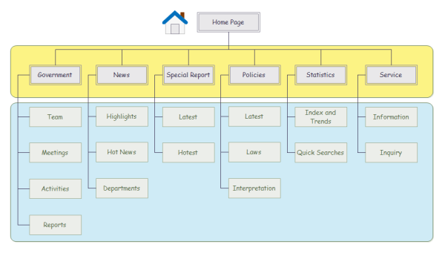
4. Website Design
Website structure (sitemap)

Slide 31
4. Website Design
Website structure (sitemap)
Used to organize complex blocks of information.
The most commonly used system
Close to the real world organization model
Easy to visualize website organization
→ Overview from the homepage

Slide 32
4. Website Design
UI/UX
Have a clear direction
No final page (no dead-end)
Stability of Web sites
Feedback and dialogue
Cross-browser compatibility (alternative)

Slide 33
UI/UX
Users are the main factor determining the success or failure of the website
Request the perfect level of interface design
Test the website ➔get feedback from users

Slide 34
Have a clear direction
Users can answer the following questions :
Where are users?
What can be done?
Where can Users continue?
Symbols, instructions should be consistent, easy to understand

Slide 35
No final page (no dead-end)
Each page has at least one link. Always give users the ability to return to the homepage or key pages of the website.
There should be no "dead-end" page, meaning the page is not capable of going to other pages.
It is recommended to include the homepage link in every page.

Slide 36
Stability of Web sites
Stable in structure and content
About the structure: the components are in place
Content:
Connections are always guaranteed to have a destination
Content must be updated to suit the content and context

Slide 37
Feedback and dialogue
Allow readers to contribute comments and feedback to readers in the fastest way
Always provide a link to the Webmaster
Long-term personnel planning

Slide 38
5. Deploy Website
After the design, testing is done, deploy Website

Slide 39
6. Maintain information, maintain website
After deployment the Website, the information must be updated regularly, there is always new data
There must be a website maintenance team to fix errors, upgrade versions...

Slide 40


Hey! Coding is easy!
END

